Slide 1
Introduction to Data Science Data Mining for Business Analytics
Brian d’Alessandro
VP – Data Science, Dstillery
Adjunct Professor, NYU
Fall 2014
Fine Print: these slides are, and always will be a work in progress. The material presented herein is original, inspired, or borrowed from others’ work. Where possible, attribution and acknowledgement will be made to content’s original source. Do not distribute, except for as needed as a pedagogical tool in the subject of Data Science.
Notes:
https://www.youtube.com/watch?v=aMDe5pODkB0 (harlan harris)

Slide 2
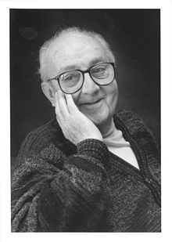
All models are wrong…
Some are useful.
- George E. P. Box

Slide 3
Model selection
Notes:
The goal of finding structure is to information from one source to reduce uncertainty about another source.
What does this mean? Conditional distribution example. I.e., carnival guy who guesses your weight. If I can see your height I can reduce uncertainty about weight.
Find some height/weight data.
Under supervised exploration:
How can we (automatically) obtain a selection of the more informative variables with respect to predicting the value of the target variable?
Even better, can we obtain the ranking of the variables?
Can think of importance as one that makes the target variable more pure. This leads to the notion of entropy.

Slide 4

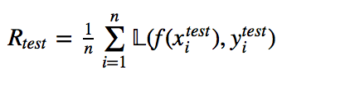
Goals of evaluation
The goal of evaluation in model building can be put quite simply: achieve the best generalization performance while avoiding overfitting.
Remember, in ERM we seek a function f(X) that minimizes the training error (or risk) on our training data.
WE ALWAYS want to measure the error on a holdout, or test set, too.
We can only be certain our models generalize if we do a correct holdout evaluation. Theory helps us design good algorithms with strong generalization and convergence results, but empirical hold-out testing is always necessary.

Slide 5
Model selection
When we model, we have many choices. We use holdout evaluation methodologies to optimize the following:
Algorithm Selection
(i.e., RF vs. Decision Tree vs. Logistic Regression vs. SVM)
Feature Selection
Hyper-parameter Selection, i.e.,
“k” in k-NN
“C” in SVM
MaxDepth, MinLeafSize in Decision Trees
Regularization Strength
The optimal configuration of these elements depends on the goals of the problem, which define an appropriate evaluation metric.

Slide 6
Basic design
When doing any sort of model selection, one usually begins by creating 3 splits of the data.
Training: the training data is used to find the optimal function given the model structure (i.e., fixed algorithm, feature set, hyper-parameters).
Training Data
Validation: the validation data is used to evaluate the loss/risk for a given model configuration. The configuration with the best loss/risk is selected as the final model
Validation
Data
Test
Data
Test: test data is not used for any parameter or model selection. It is only used as a generalization measure.

Slide 7
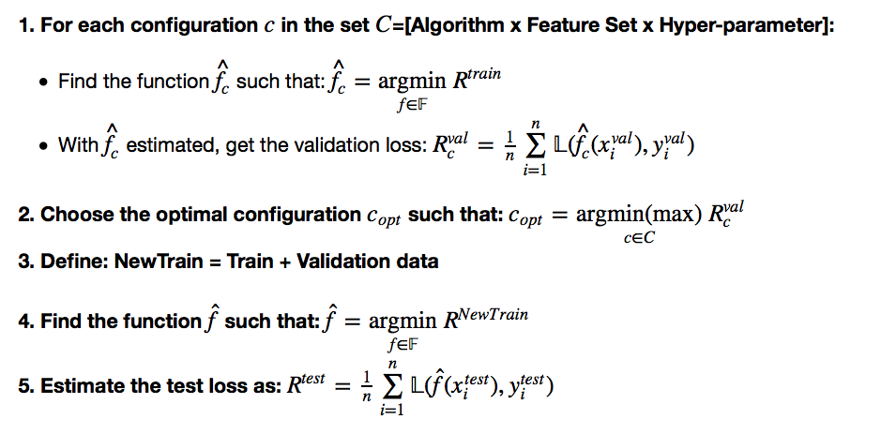
Example model selection routine
Define: Training Data
Define: Validation Data
Define: Test Data

Slide 8
Some notes on validation risk
The validation loss metric does not have to be the same as the training loss.
Sometimes we need a loss metric for an application that is not very easy or even possible to directly minimize.
I.e., we use logistic-loss to find f but we really need a loss metric that enables optimal ranking (such as AUC)
We might want to minimize a training loss metric, but maximize the validation metric (again logistic-loss vs. AUC)

Slide 9
Cross-validation
Sometimes we don’t have enough data to do a single train/validation/test split.
We can “recycle” data by using k-fold cross validation as our validation scheme.
Fold 1
Fold 2
Fold 3
…
Fold k-1
Fold k

Slide 10
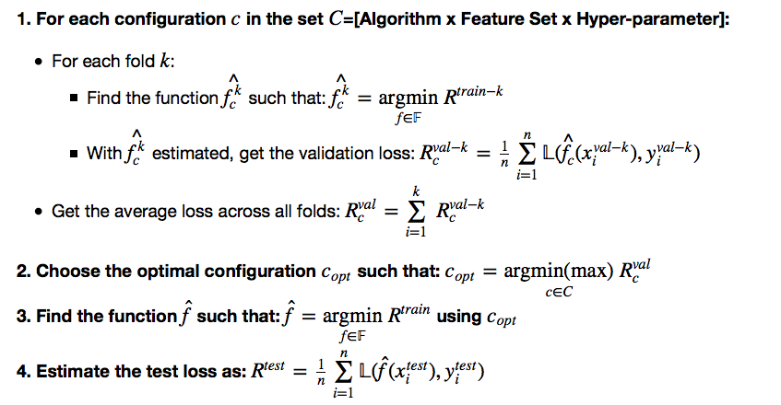
Example x-validation scheme
Define: Training Data
Define: Test Data

Slide 11
Some x-val notes
How should we choose split size or k?
There is no golden rule that defines how big training, validation and test sets should be.
You want each data set to be big enough to reduce the variance of your estimates.
Estimation variance comes in two flavors – variance of the function being fit to the training data and variance of the estimate of the validation/test risk.
Good heuristics are 50%/25%/25% for train/val/test splits and k=5 or 10 for x-validation.
Also, data should be randomly split with no overlap in instances between sets.

Slide 12
Estimation variance
Care should always be taken to reduce the variance in the estimation of validation/test risk as well as the optimal function f.
Variance is driven by two factors.
Training/Fit:
As the ratio of the the complexity of the model to the size of the training data increases, the model is likely to overfit, and this increases the variance of the model.
Small Test/Validation Sets:
- The test/validation risk is a mean of the per-sample risk across the data set. The standard error of the mean estimator decreases proportional to sqrt(n).

Slide 13
The bootstrap procedure
We can use the bootstrap procedure to empirically compute the variance of our estimators and incorporate the variance estimates into our selection mechanisms.
The Bootstrap Procedure:
Given original dataset Dº of size n, sample with replacement n times into a new dataset D^{b}.
2. Perform estimation process on D^{b}.
3. Repeat m times
4. Compute mean/variance over m estimation steps
Dº
D^{b}

Slide 14
Example model selection
We have a dataset with 14 features, roughly 10k examples and only 253 positive examples.
Goal
Build a classifier that has good ranking properties.
Solution
We’ll use Logistic Regression because it is robust in small-sample sizes and imbalanced classes, and also returns a score instead of just label predictions
With small data we expect high variance, so we need to use regularization
We’ll split data into 80/20 train/test and run 10-fold xvalidation on train.
We’ll use AUC to choose a regularization weight
We’ll bootstrap the test set estimate of AUC to get an empirical measure of its variance

Slide 15
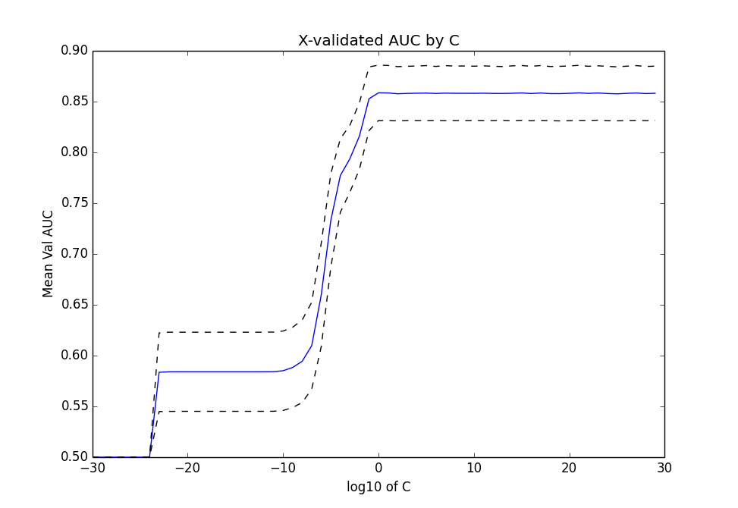
Results of xvalidation
With less regularization we actually do better here (strong signal in the features). But we still see that between 1 to 10³⁰ we get nearly the same results. It would be better if we can zoom into the region where performance is better.

Slide 16
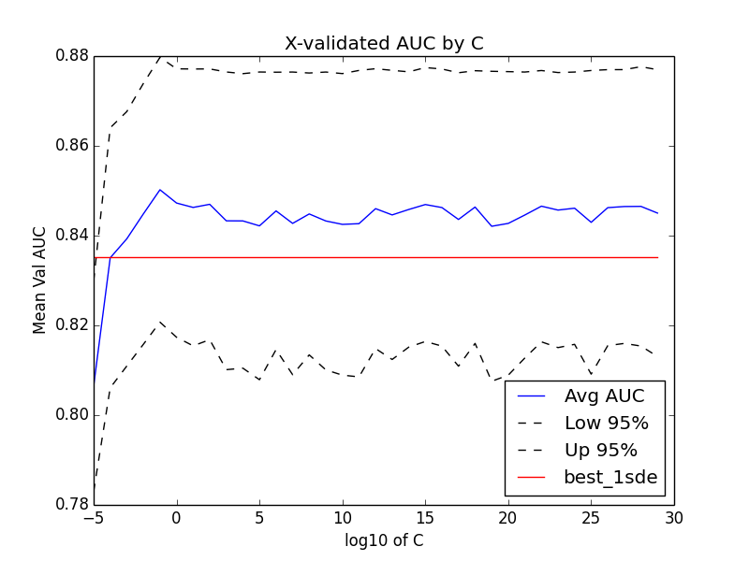
Results of xvalidation -zoomed
When we zoom in we can see that statistically speaking, everything above C=1 is essentially the same (i.e., strongly overlapping confidence intervals). There are two ways to choose C here.
Criteria 1:
Choose option with
max(Xval AUC)
Best Criteria 1
Criteria 2:
Find all options where
AUC>=max(AUC) – 1stderror
Choose least complex option (highest regularization)
Best Criteria 2

Slide 17
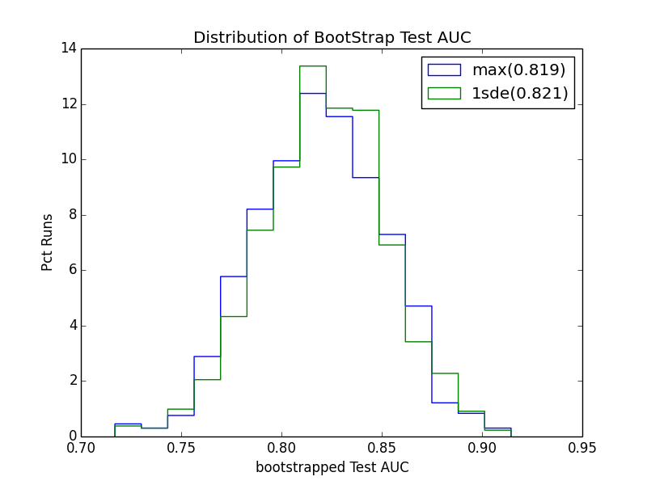
Bootstrapped out-of-sample
Now that we’ve selected the model hyper-parameters, let’s look at the test error. To get a sense of the variance, we run bootstrap analysis. In real situations, we wouldn’t use the test set to choose which selection criteria is better, but we can use it to construct 95% confidence intervals of our test error.

Slide 18
Diagnosing bias-variaNce
We know that models with more complexity fit the training data well, and thus have an expected lower training error.
Example sources of complexity:
The number of features
The degree of the features in linear models
The max depth of a decision tree
The training error balancing term C in SVM
The size of the neighborhood k in kNN
We know have tools for understanding how well any given model generalizes.
If a model doesn’t generalize well, how do we know if bias or variance is the problem?

Slide 19
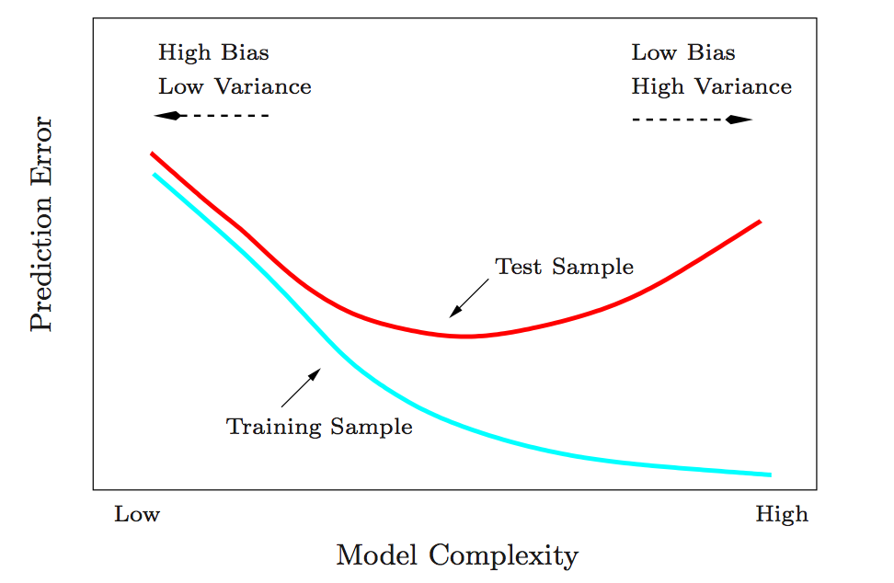
Diagnosing bias-variaNce
Comparing training vs. out-of-sample error as a function of complexity can indicate where we are on the bias-variance tradeoff.
Image Source: Elements of Statistical Learning

Slide 20
Evaluation metrics
Notes:
The goal of finding structure is to information from one source to reduce uncertainty about another source.
What does this mean? Conditional distribution example. I.e., carnival guy who guesses your weight. If I can see your height I can reduce uncertainty about weight.
Find some height/weight data.
Under supervised exploration:
How can we (automatically) obtain a selection of the more informative variables with respect to predicting the value of the target variable?
Even better, can we obtain the ranking of the variables?
Can think of importance as one that makes the target variable more pure. This leads to the notion of entropy.

Slide 21
Reminder
You will never build the perfect model… but we can always have a best model.
So far we have discussed the following design options:
[ Algorithm, Feature Set , Hyper-parameters (complexity)]
We also need to choose an evaluation metric!

Slide 22
The right metric depends on your goals
Ranking - Who are the top k prospects for my campaign, or what 10 items should I recommend?
Classification – Is this email spam or not? Is this number a ‘1’ or a ‘7’?
Density Estimation – What is the probability that this transaction is fraud? What is the expected spend of a new credit card customer?

Slide 23
Metrics for these Goals
Ranking
Area under the Receiver Operator Curve (AUC)
Area under the Cumulative Lift Curve (ACLC)
Classification
Lift (LFT)
Accuracy (ACC)
F-Score (FSC)
Precision (PRE)
Recall (RCL)
Density Estimation
Mean Absolute Error (MAE)
Mean Squared Error (MSE)
Cross-Entropy /Log-Likelihood (LL)

Slide 24
Train vs. Val/test loss
We don’t need to use the same error/loss/risk function on our training data as we do our validation or test data.
Training Loss
Usually used because they are well posed and “easy” to actually optimize (i.e., quadratic and smooth).
Logistic Loss, Hinge Loss, Least Squares etc.
Testing Loss
Often the most suitable loss function is not quadratic or too complex to train efficiently.
Precision, AUC, Recall.
vs.

Slide 25

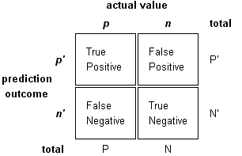
Confusion Matrix
Many of the metrics we use derive from the confusion matrix. For binary classification we assume there exists some real valued function f(x) and a decision threshold δ.
Higher
Model Prediction
Threshold
Lower

Slide 26
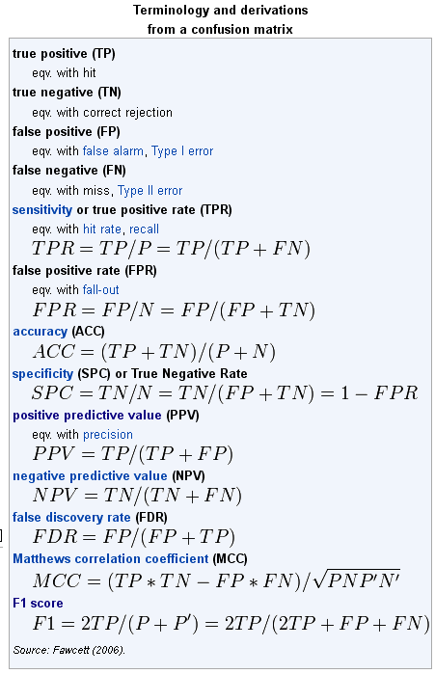
Classification Metrics
We can derive many classification metrics from the confusion matrix.
Source: http://en.wikipedia.org/wiki/Receiver_operating_characteristic#Area_under_curve

Slide 27
Some exposition
Precision - of all the instances I predict are positive, how many actually are positive? Lift is the precision normalized by the base rate (P(Y)).
Recall- how many of the total positives out there did I classify as positive?

Slide 28
Towards A Ranking Metric
Classification metrics depend on choosing a single threshold. But what if you don’t know or need the threshold?
Higher
Higher
Higher
Higher
Threshold 1
Model Prediction
Threshold 2
Threshold 3
Threshold 4
Lower
Lower
Lower
Lower
For each threshold we will get different accuracy, lift, precision and recall.
We want an evaluation method that considers the trade-off on these metrics when using different thresholds.

Slide 29
The Thresholding Trade-Off
Each threshold we choose creates a trade-off between false positive rate and true positive rate.
Threshold 4
Threshold 3
True Positive Rate: TP/(TP+FN)
Threshold 2
Threshold 1
False Positive Rate: FP/(FP+TN)

Slide 30
The ROC Curve
If we consider every threshold and plot the trade-off, we arrive at the ROC curve.
Threshold 4
Threshold 3
True Positive Rate: TP/(TP+FN)
Threshold 2
Threshold 1
False Positive Rate: FP/(FP+TN)

Slide 31
The Area Under the ROC Curve
The area under this curve gives a comprehensive summary of how well your classifier ranks.
True Positive Rate: TP/(TP+FN)
False Positive Rate: FP/(FP+TN)

Slide 32
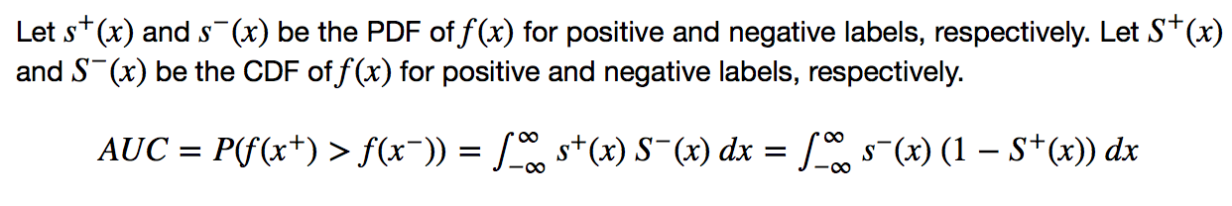
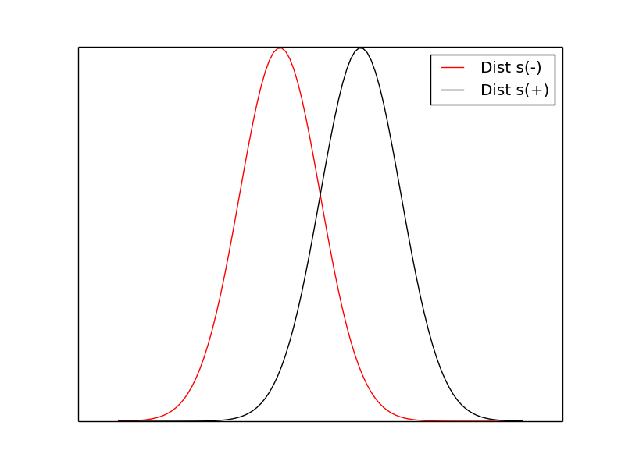
Probabilistic interpretation of AUC

Slide 33
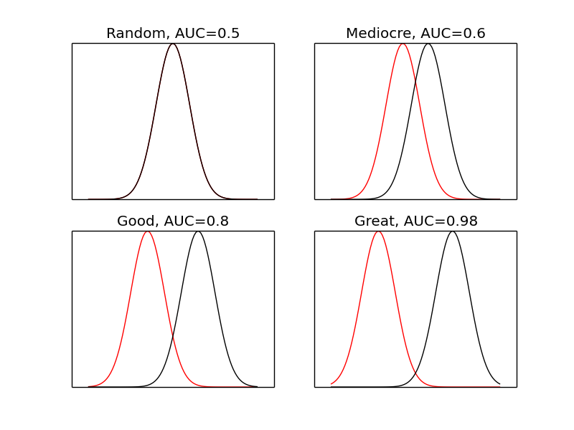
Different examples
A good AUC depends on the problem. Although AUC=0.6 means reasonably bad separation of the classes, it could still create value. Also, really high AUCs are often too good to be true and should be treated with suspicion.

Slide 34
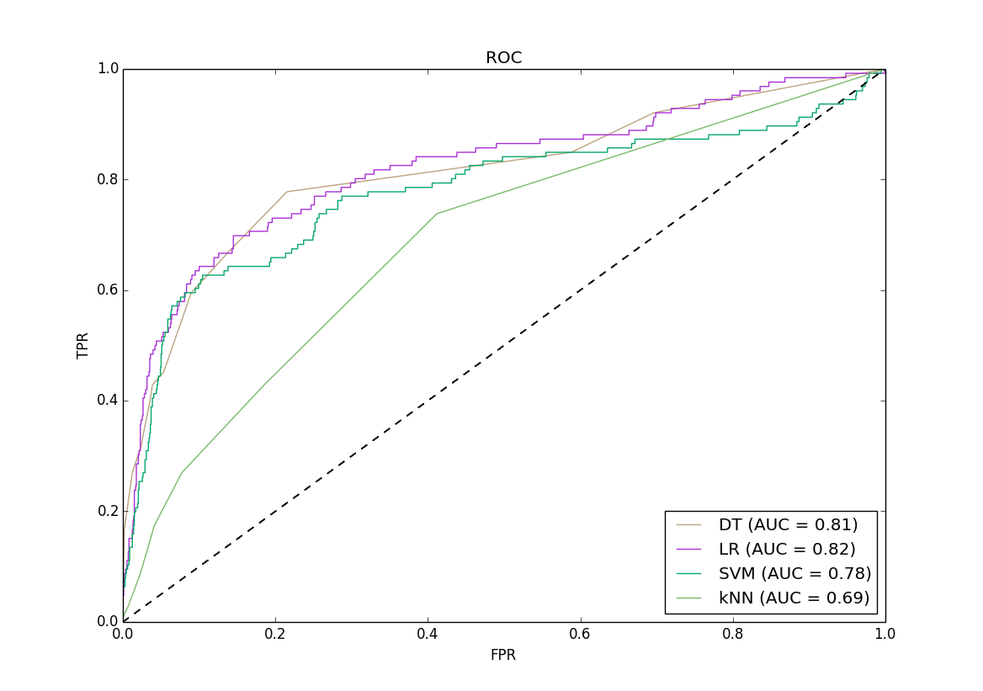
Comparing aucs
We built 4 different classifiers using the ads dataset. We can compare the models using ROC analysis.
A universally better model has higher TPR at all FPR (LR > kNN)
Some models overlap. Better model depends on whether you value TPR or FPR more (DT is best where FPR<0.05)

Slide 35
Fun AUC Facts
Nice interpretation: gives the probability that a positive instance will have a higher score than a negative instance (equivalent to Mann-Whitney U statistic)
Base Rate Invariant: AUC is invariant to P(+) in the data set (unlike lift metrics). Useful for doing comparisons across data sets with different base rates. Or after down sampling.
Is Nicely Bounded: AUC scores range from [0,1], where 1 is a perfect classifier and 0 is a perfectly wrong classifier. A random classifier has an exact score of 0.5.

Slide 36
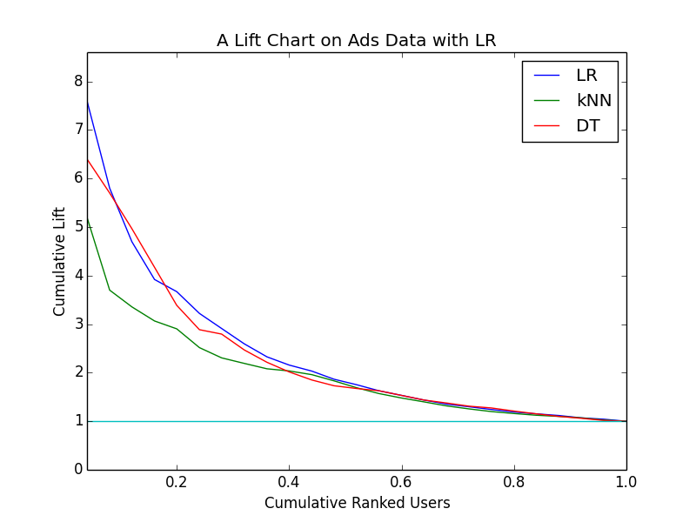
lift
Lift can be both a ranking metric and a classification metric. For ranking, we can see which model fits the entire distribution of users better. For single classification, we can measure lift for a desired targeting threshold.
Lift Properties
Nice interpretation: the lift tells you exactly how many more positive outcomes you might expect relative to the baseline strategy. Also lends well to economic analysis
Base Rate Non-Invariant: Lift will change if you alter P(+). This has implications for down sampling or for comparing models from different datasets.

Slide 37
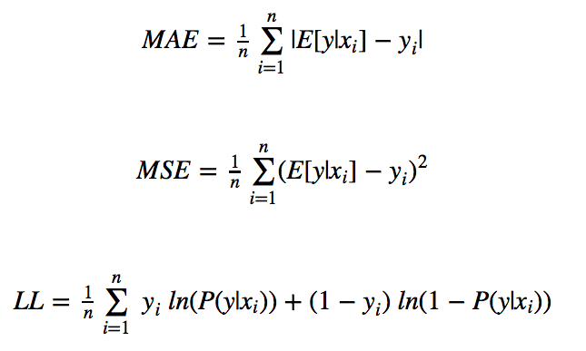
Density Estimation
Sometimes you want to evaluate how well your model estimates the underlying conditional distribution of your data: P(Y|X)

Slide 38
Back to ads data
Scenario 1:
Constraints: a budget k and a population n (k and n on the same unit scale)
Goal: Maximize the ROI for the client
Solution: Target (k/n)% of the population, such that the selected set of k prospects maximizes the total number of conversions
What metrics can we use to choose the best model

Slide 39
Back to ads data
Scenario 1:
Constraints: a budget k and a population n (k and n on the same unit scale)
Goal: Maximize the ROI for the client
Solution: Target (k/n)% of the population, such that the selected set of k prospects maximizes the total number of conversions
If we know k and n: Lift or Precision
If we don’t know k and n: AUC

Slide 40
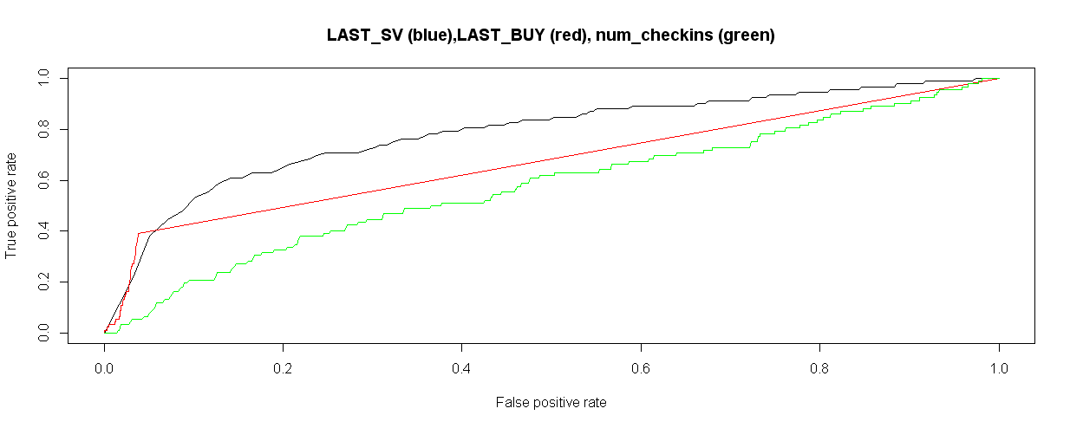
Roc curve of individual features
We can analyze the predictive power of individual features using AUC curves. Note the interesting shape of LAST_BUY AUC. What causes that?

Slide 41
Back to ads data
Scenario 2:
Constraints: each impression costs $C, for each conversion, receive $Q, unlimited budget
Goal: Maximize profit for the firm
Solution: Target every opportunity where
E[Value]= P(Conv|X)*$Q>$C
What metrics can we use to choose the best model

Slide 42


Back to ads data
Scenario 2:
Constraints: each impression costs $C, for each conversion, receive $Q, unlimited budget
Goal: Maximize profit for the firm
Solution: Target every opportunity where
E[Value]= P(Conv|X)*$Q>$C
To get a well calibrated estimate of P(Y|X), use

Slide 43
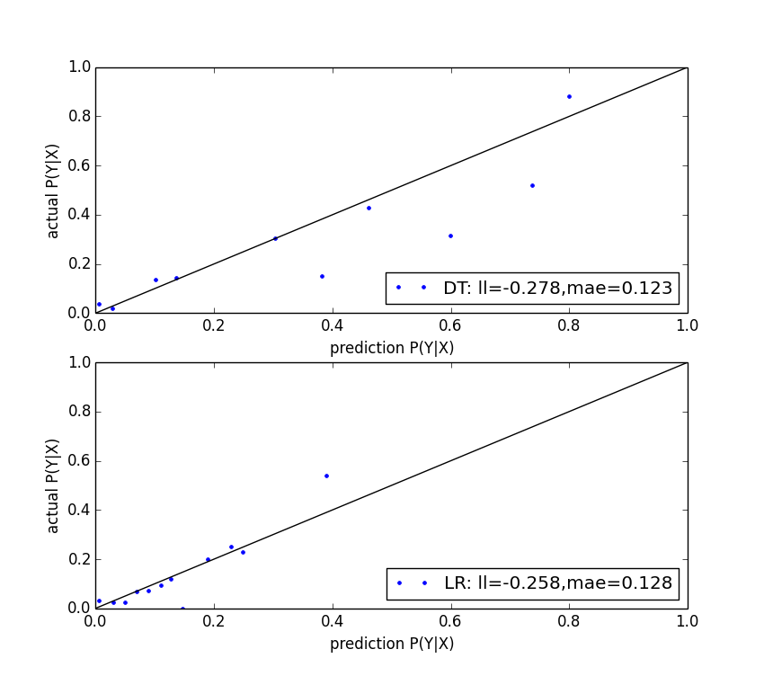
Calibration plots
We can generate calibration plots to visually inspect how well the predictions match the outcomes. To make the plot, we bin test instances by P(Y|X) and take mean(Y) against mean(P(Y|X)) for each bin.
Observations:
DT predicts a higher range of probabilities
LR is very well calibrated for lower valued predictions but not as good in the upper range.
Why is MAE lower for DT?

Slide 44
metrics don’t always agree
It is often the case that different metrics don’t agree (in terms of rank) when comparing models built with different design choices.
In this case we build univariate LR models on each feature and compare AUC, LL and Gini Index (from SK Learn Decision Tree)
Feature | AUC | -LL | Gini
visit_freq | 0.781 | 0.282 | 0.147
last_visit | 0.780 | 0.306 | 0.528
multiple_visit | 0.740 | 0.280 | 0.000
sv_interval | 0.717 | 0.323 | 0.046
buy_freq | 0.673 | 0.274 | 0.151
isbuyer | 0.670 | 0.278 | 0.000
last_buy | 0.665 | 0.321 | 0.015
buy_interval | 0.581 | 0.310 | 0.000
multiple_buy | 0.581 | 0.297 | 0.000
uniq_urls | 0.580 | 0.322 | 0.051
num_checkins | 0.567 | 0.326 | 0.062
expected_time_visit | 0.564 | 0.329 | 0.000
expected_time_buy | 0.518 | 0.327 | 0.000

